Slide 1
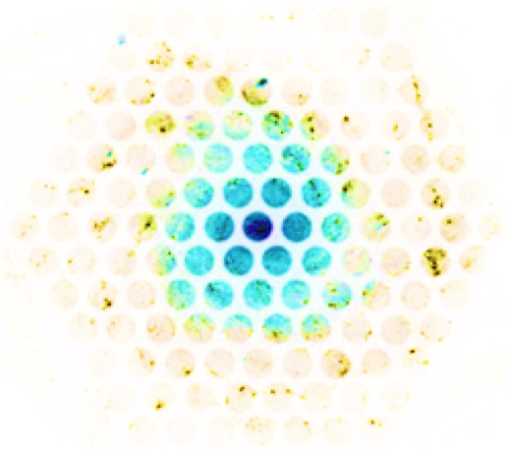



The Mass-Metallicity Relation
Brett Andrews
Astron 3580: Galaxies and Extra-galactic Astronomy
3.30.2018

Slide 2
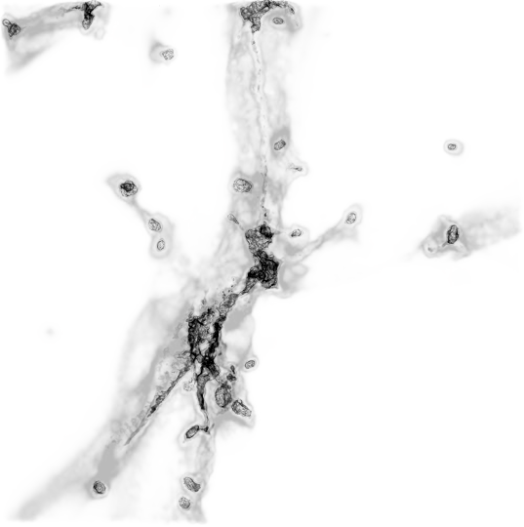
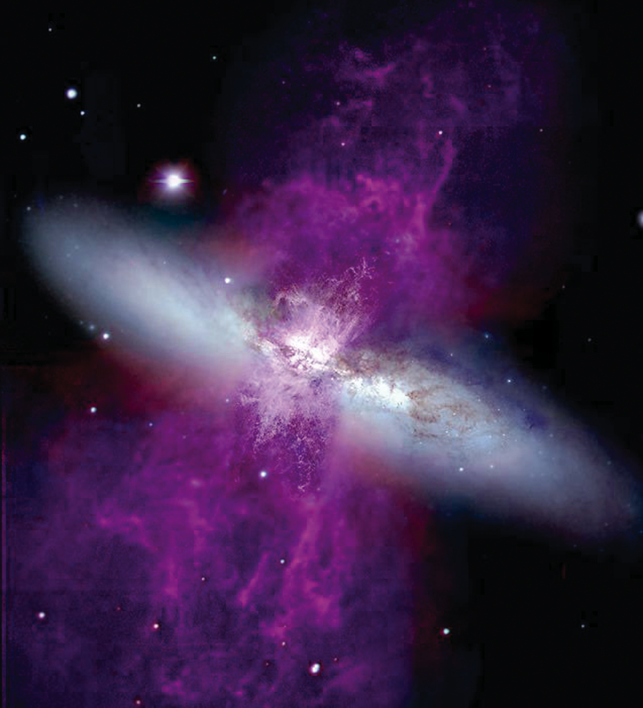
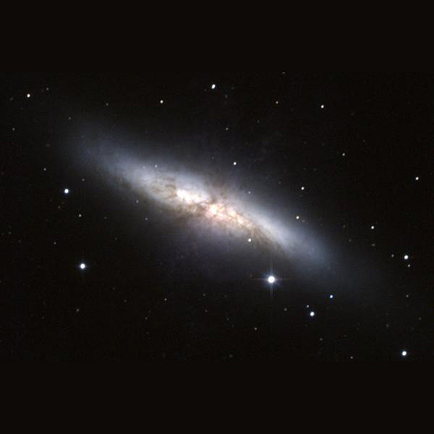
Credits: simulation snapshot → Dylan Nelson
M82 → : P. Challis, WIYN telescope, &
HST (Hα → purple)
Notes:
Inflow is difficult to observe

Slide 3
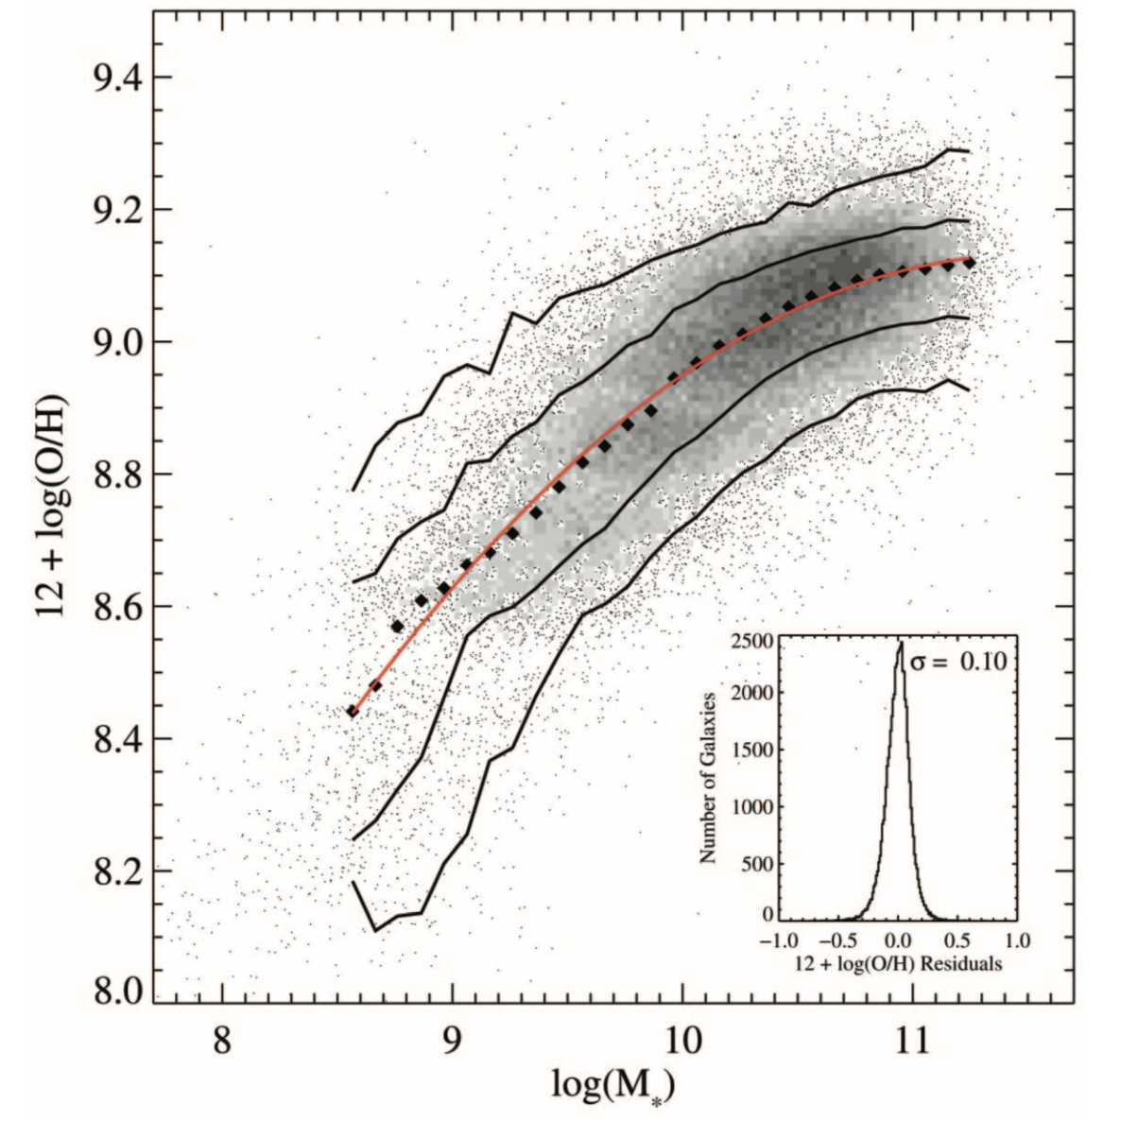
Mass-Metallicity Relation
Powerful observational constraint on galaxy formation models!
Features:
normalization
low mass slope
turnover mass
scatter
evolution
SFR-dependence
Tremonti et al. (2004)

Slide 4
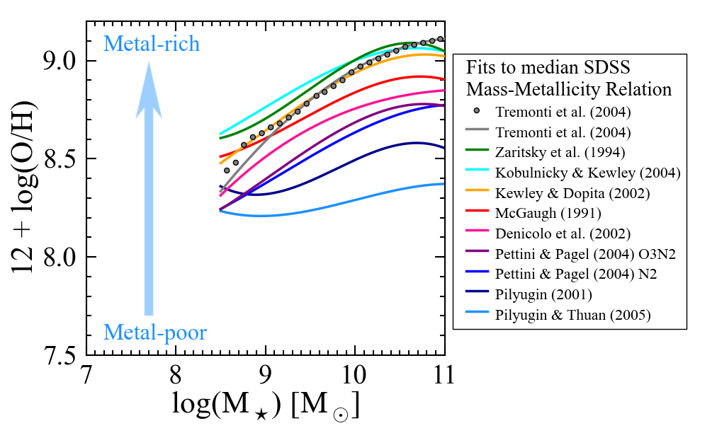
Strong line metallicities suffer from large systematic uncertainties.
Fits from Kewley & Ellison (2008)
Notes:
--Properties of MZR depend heavily on the metallicity calibration.
--There are many tenths of a dex uncertainty in metallicities derived from the same input spectra.
--Different strong line methods work better or worse in different regimes. Empirical methods work best at low metallicity because the auroral lines that they are calibrated on are strongest at low metallicity.
--None of the strong line calibrations work consistently well over the whole stellar mass range, unlike our direct method metallicities.
--The interpretation of the physical processes that drive the mass—metallicity relation is subject to these uncertainties, too.

Slide 5
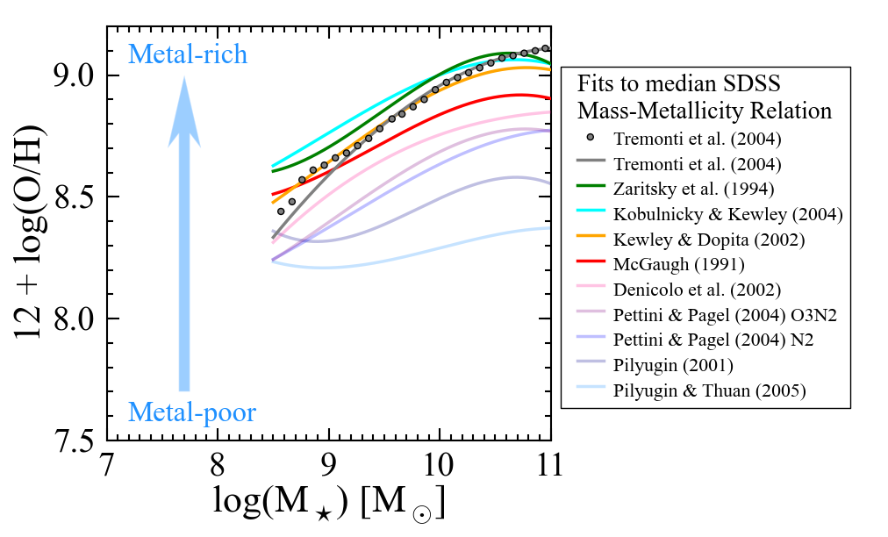
Theoretical Calibrations
Fits from Kewley & Ellison (2008)
Notes:
STARBURST99 → Stellar Population Synthesis
MAPPINGS and CLOUDY

Slide 6
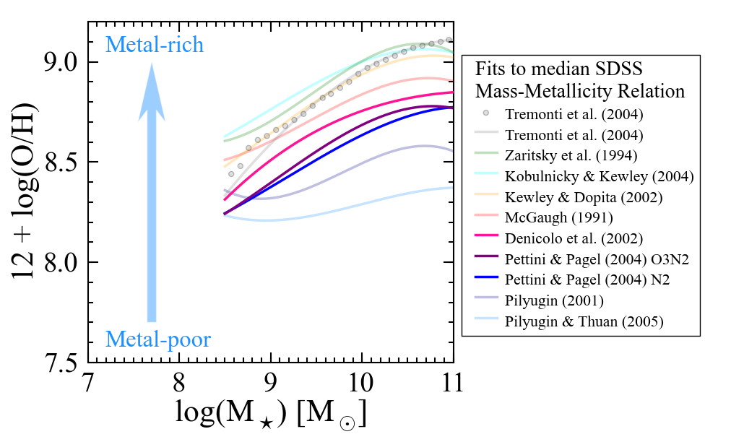
Semi-Empirical Calibrations
Fits from Kewley & Ellison (2008)

Slide 7
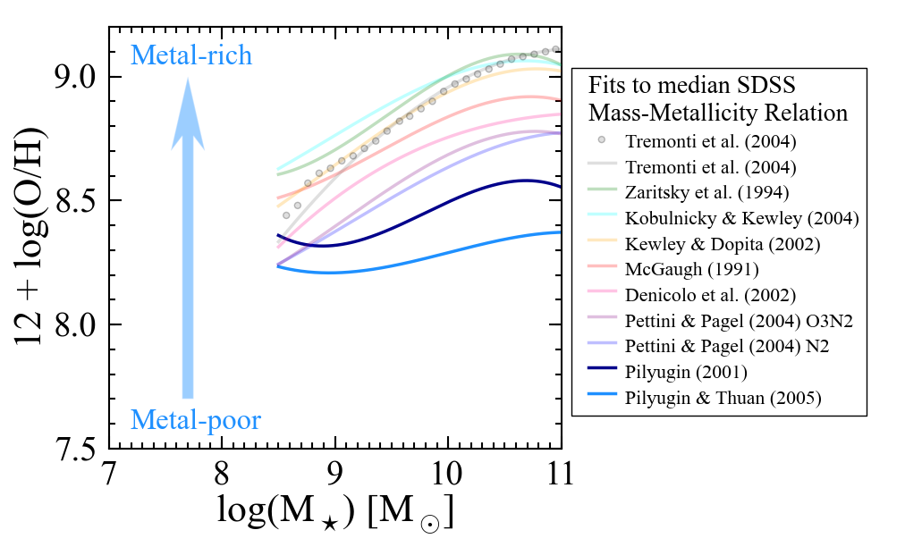
Empirical Calibrations
Fits from Kewley & Ellison (2008)

Slide 8
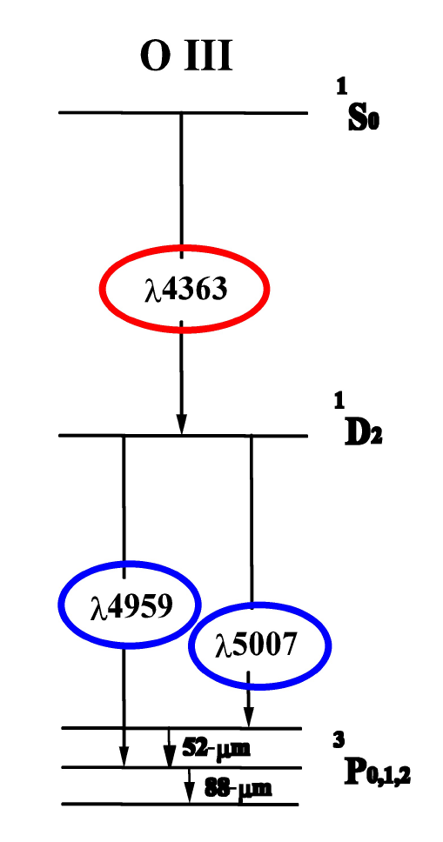
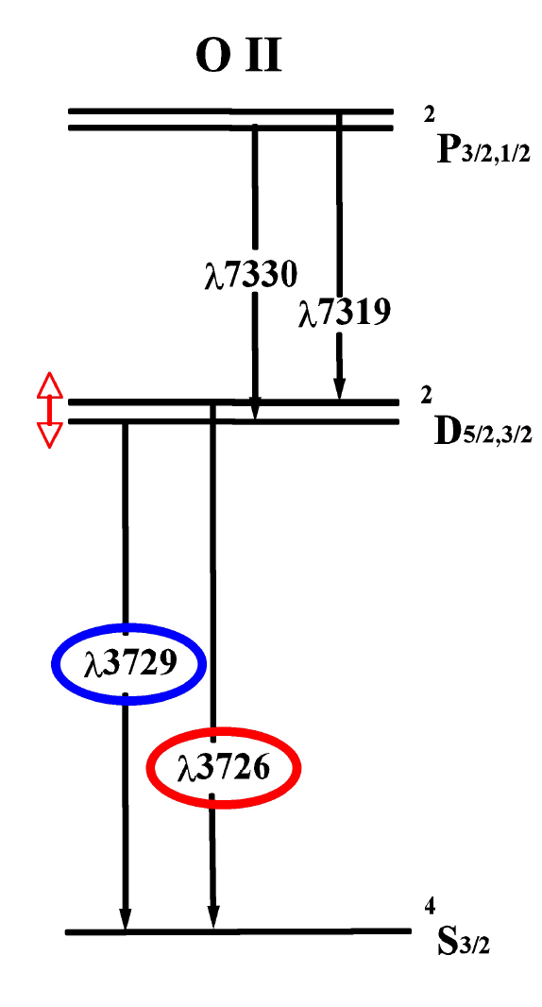
Auroral Lines: Temperature-sensitive
Auroral lines
Strong lines
M. Westmoquette

Slide 9
Direct Method
limiting factor
[OIII] λ4363
[OIII] λλ4959, 5007
[OIII] λλ4959, 5007
→
+ Te[OIII]
Hβ
→
O++
H
O
O+
O++
Metallicity:
=
+
H
H
H
(Repeat for O+)
Notes:
Use 5 level atom model (De Robertis et al. 1987; Shaw & Dufour 1995)
Assume low density limit (n_{e} ~ 100 cm⁻³)

Slide 10
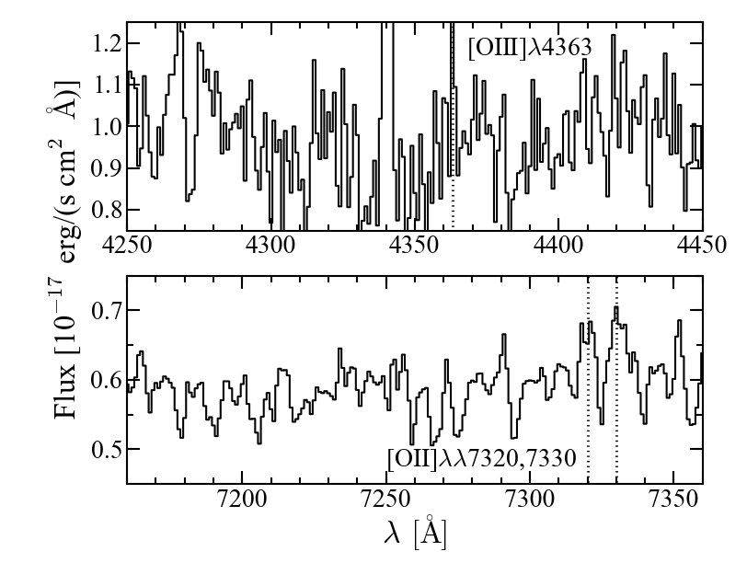
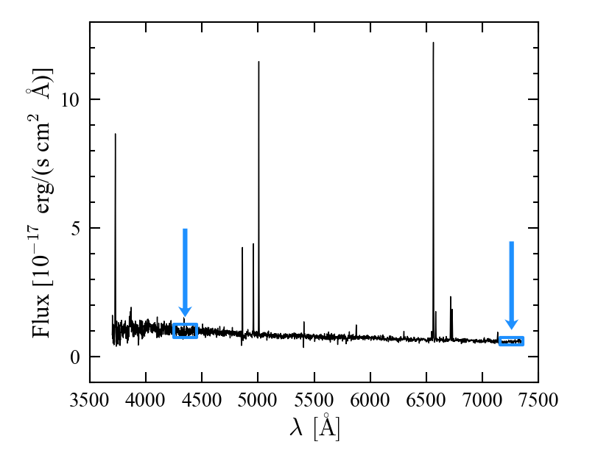
Auroral lines are very weak
[OIII]
[OII]
Hβ
Hα
Hγ
[SII]
[NII]

Slide 11
Auroral Lines of a Single Galaxy

Slide 12
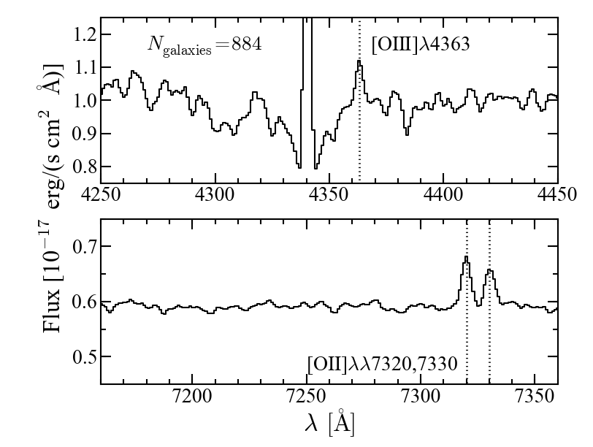
Stack of Galaxies
stellar absorption lines
Notes:
--normalized the flux to 4400—4450 Å (for whole spectrum stellar continuum fit)
--co-added the spectra using the arithmetic mean
--variance of the mean is less than the variance of the median

Slide 13
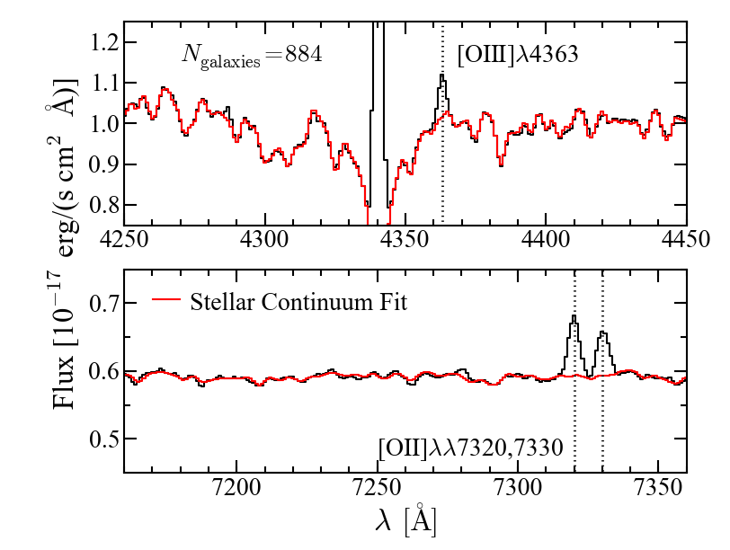
Fit the Underlying Stellar Spectrum
Stellar continuum fit with STARLIGHT stellar synthesis code (Cid Fernandes et al. 2005)
Notes:
--SNR limited by stellar continuum subtraction

Slide 14
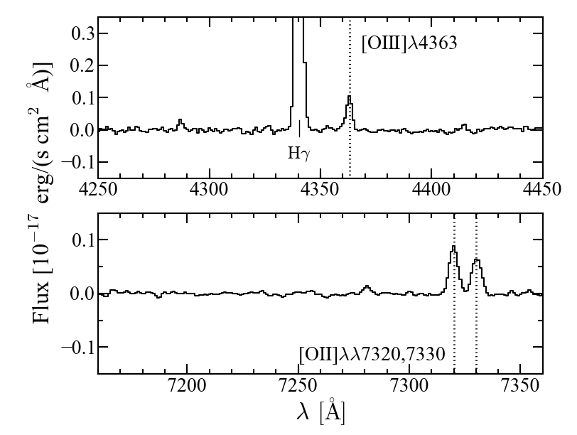
Final Spectrum

Slide 15
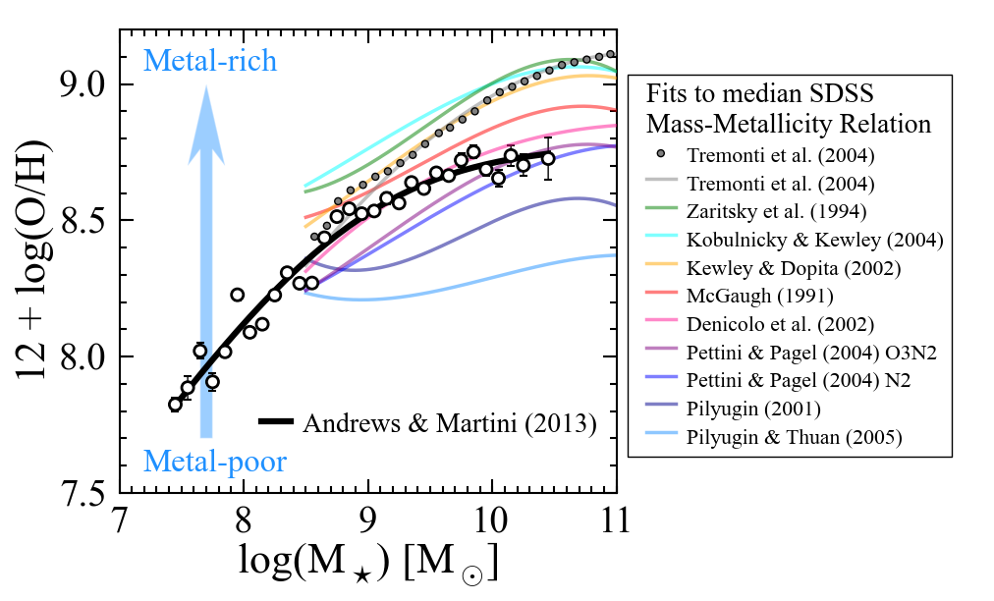
Direct Method Mass—Metallicity Relation
Fits from Kewley & Ellison (2008)
Notes:
Putting it into context. The direct method mass—metallicity relation extends over 3 dex in Mstar. Now we’re going to look at how its normalization and low mass slope differ from the T04 MZR.

Slide 16
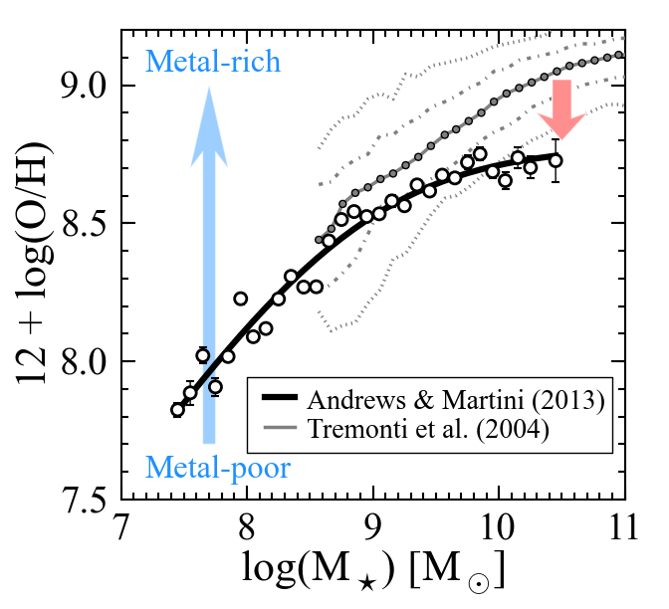
Normalization
Galactic winds are efficient at ejecting metals…
Notes:
T04 asymptotic metallicity = 9.22
Direct method asymptotic metallicity = 8.78

Slide 17
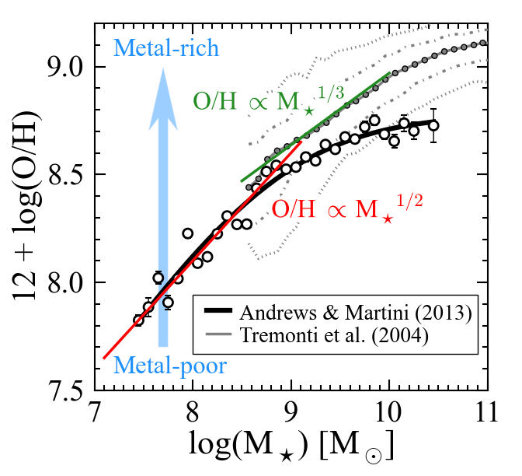
Low Mass Slope
…especially in low mass galaxies.

Slide 18
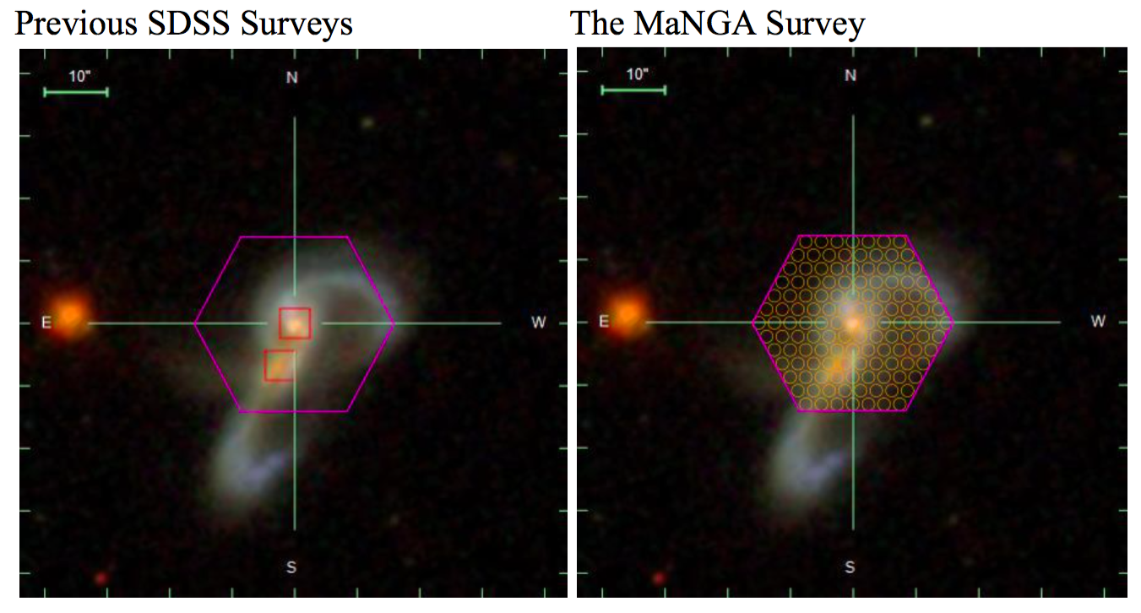
Previous SDSS Surveys
MaNGA
Credit: Mike Blanton
Notes:
Mergers and interactions can accelerate this process and result in the creation of spheroids.
Previously, SDSS took spectra of about 1 million galaxies, but only at their centers.
MaNGA is studying 10,000 nearby galaxies in exquisite detail by taking spectra across their faces with integral field units.

Slide 19
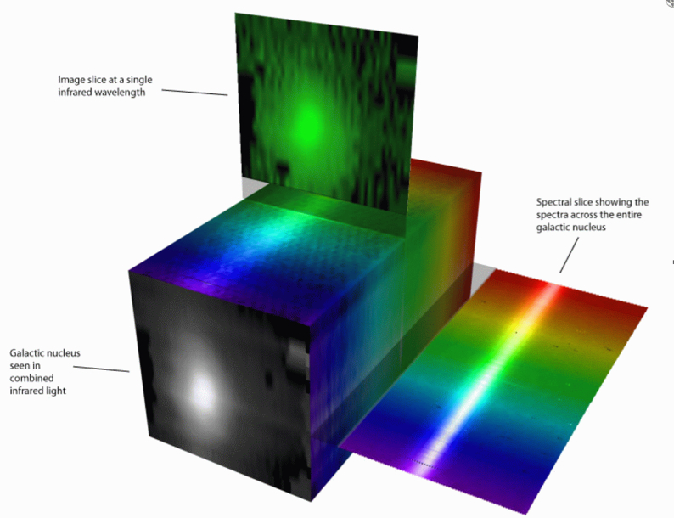
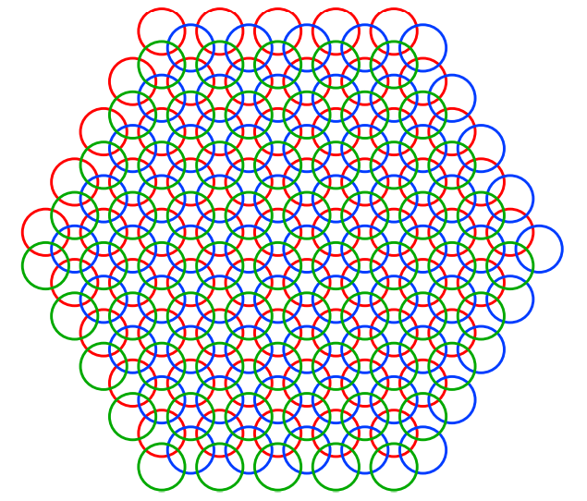
MaNGA Data Reduction
Row-Stacked Spectra Cubes
(spectrum from each fiber at
each dither position)
Law et al. (2015)
Credit: Stephen Todd (ROE) & Douglas Pierce-Price (JAC)
Notes:
Define spaxel

Slide 20
MaNGA Data Analysis
Fit stellar continuum
Fit emission lines
Measure spectral indices
Westfall et al. (in prep.)

Slide 21
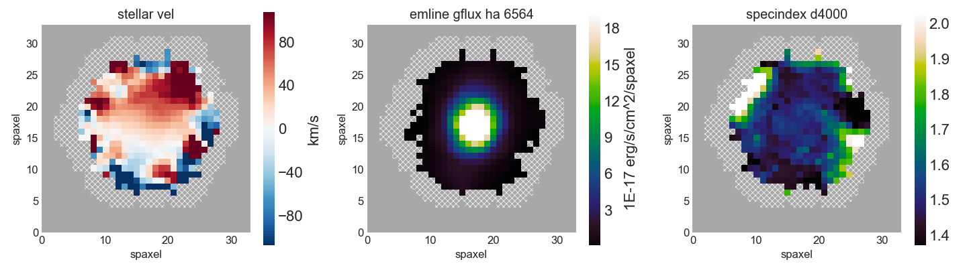
MaNGA Analysis Products
Model Cubes
Maps

Slide 22
Analysis Properties
Kinematics (stellar & gas)
velocity & sigma
Emission line fluxes
Hα−Hε, HeI, HeII, [OI], [OII], [OIII], [NII], [SII], [SIII]
Spectral Indices
D4000

Slide 23
Bin Types
VOR10 (Voronoi binning to S/N = 10)
SPX (unbinned)

Slide 25
MaNGA Science Drivers
How does gas accretion drive growth?
How do mergers, stellar accretion, and instabilities build spheroidals?
What quenches star formation? Does is it depend on environment?
How is angular momentum distributed and transferred during formation?
How do various mass components assemble and influence one another?

Slide 26
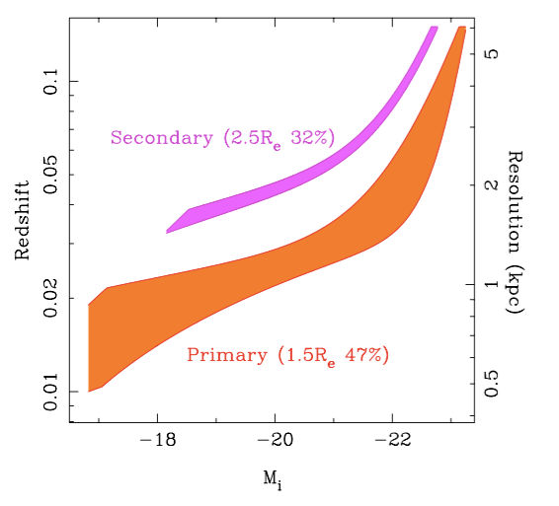
MaNGA Sample Design
M★ > 10⁹ M
Flat distribution in M★
Two main subsamples: 1.5 and 2.5 R_{effective}
Ancillary programs:
5-10% of bundles
Bundy et al. (2015)

Slide 27
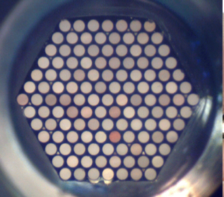
MaNGA Overview
MaNGA: Mapping Nearby Galaxies at Apache Point Observatory
One of three main sub-surveys of SDSS-IV (2014-2020)
PI: Kevin Bundy. Over 160 members at 50+ institutions.
Integral Field Unit (IFU) observations of 10,000 nearby galaxies
z = 0.01 — 0.15
λ ~ 3,600 — 10,300 Å
R ~ 1400 — 2600 (115 — 215 km/s)
Spatial resolution: 1.3 — 5.1 kpc

Slide 28
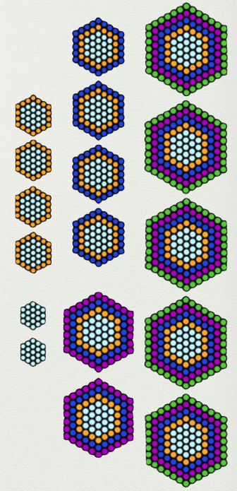
IFU Sizes
19 fibers
37 fibers
91 fibers
61 fibers
127 fibers
Credit: Kevin Bundy
Notes:
12 7-fiber mini-bundles for spectrophotometric calibration. 92 single fibers for sky subtraction.

Slide 29
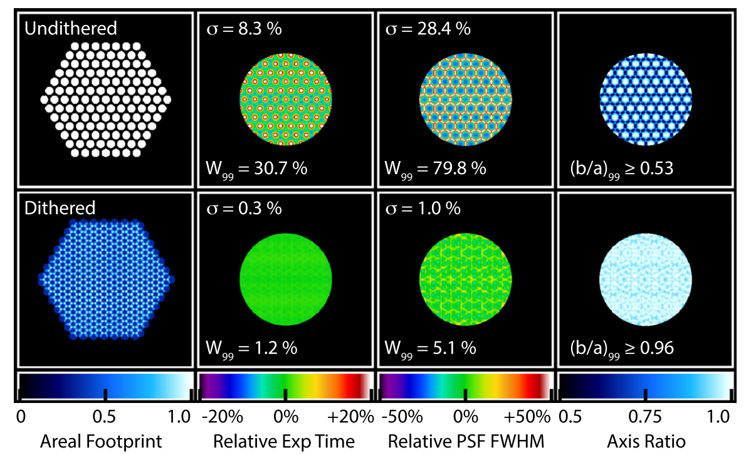
Dithering
Law et al. (2015)

Slide 30
MPL-6
~4750 galaxies
Extensive testing of the stellar kinematics
Improved emission-line fitting
tied kinematics and tied fluxes of doublets
Hybrid binning scheme
S/N > 10 for stellar kinematics and individual spaxels for emission lines
Extended set of spectral index measurements

